Slide 1

Operant Conditioning: Case Study Skinner’s Box
ATPSY Year 12 ATAR Psychology

Slide 2

Review
Exam Questions:14 minutes

Slide 3
Learning Intentions
schedules of reinforcement – fixed, variable, interval and ratio
study: Skinner box (Skinner, 1948)

Slide 4
Success Criteria
Compare the effectiveness of different reinforcement schedules
Describe the procedures, findings, limitations and strengths of Skinner’s Box experiment.

Slide 5


Slide 6
Reinforcement schedules
Continuous reinforcement is most effective when learning a new behaviour (linking neutral stimulus to unconditioned stimulus and response).
Interval reinforcement strengthens learned behaviours by preventing extinction

Slide 7
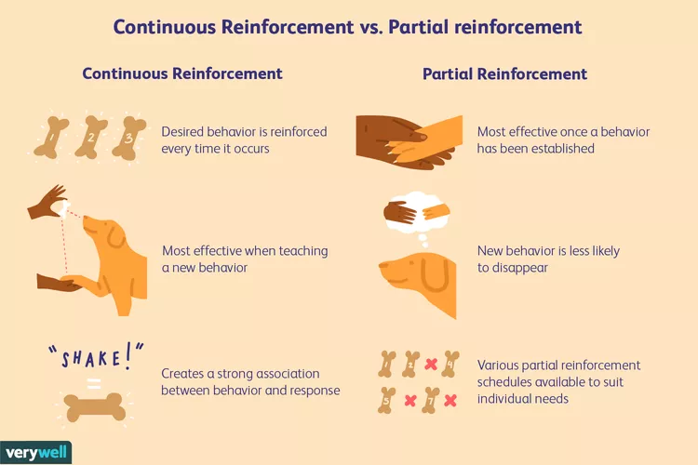

Slide 8
Intervals
Intervals could also be:
Fixed, eg reward every hour
Variable, eg random timing or number of prompts
Ratio, eg reward every three prompts

Slide 9
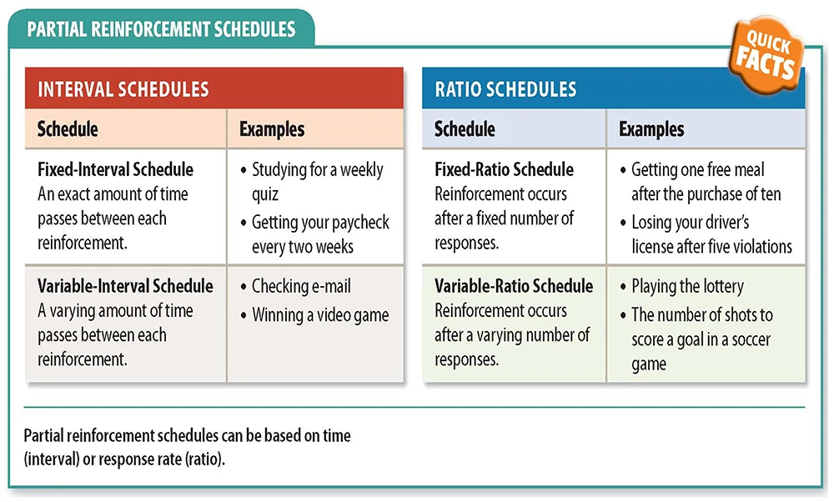

Slide 10


Slide 11
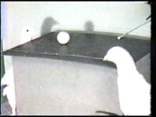

Slide 12
Strengths
Simplicity of procedure and design
Reliable and generalisable to many other species
Adaptable to many learning conditions (shapes, colours, etc) for both classical and operant conditioning

Slide 13
Weaknesses
Over-simplifies learning
Reduces all behaviours/stimuli etc to “good or bad”
Assumes that we are all “blank slates” when it comes to learning, ie ignores genetic or other cognitive influences, so not entirely generalisable to humans .

Slide 14
Success Criteria
Compare the effectiveness of different reinforcement schedules
Describe the procedures, findings, limitations and strengths of Skinner’s Box experiment.

